Slide 1
Project 1: Sleep Study
Lydia Bartnick
Anna Collawn
Gil Fernandez
Jared Sletto

Slide 2
Overview
Exploring the different relationships within the dataset.
Is there a relationship between sleep duration, quality of sleep, and physical activity with different physiological responses?
Does age, gender, and profession play a role in the duration and quality of sleep?

Slide 3
What impact does age have on stress and sleep?
Why can’t I pull those college all nighters anymore?
Do we get more stressed out when we age due to sleep?

Slide 4
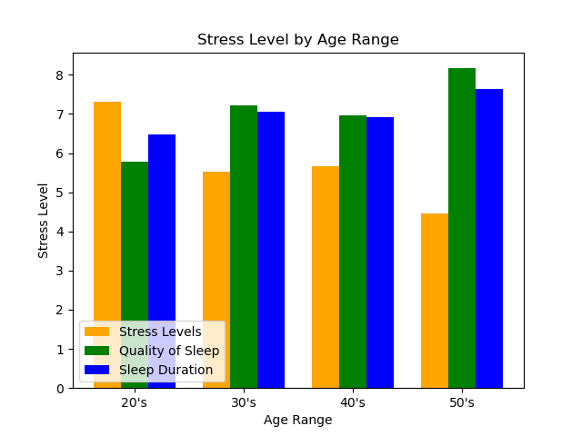
On average, people who slept more were less stressed
Bar graph shows the averages of each category by age group.
Our data csv file included an age column
Created bins and calculated the average per bin
Why does stress increase in 40s and sleep decrease?

Slide 5
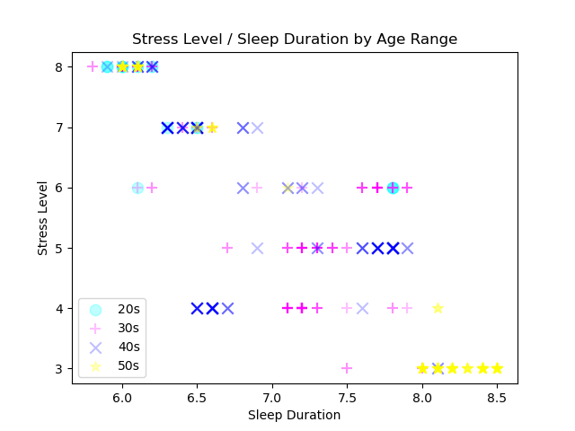
All Participants – Sleep Duration
Negative relationship
~50 points used on this graph
354 participants
Used different shapes and colors to show different age groups
Decreased the alpha so bolder colors are more frequent and can see other symbols
No regression lines / Too busy

Slide 6
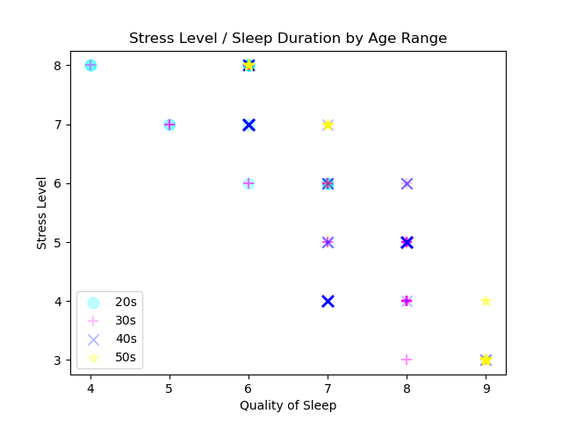
All participants – Quality of Sleep
Only 15 points on this graph
Still 354 participants
No one in their 50s ranked their quality lower than 6.
No one in their 20s ranked their quality higher than 7.
Yet, there are no visible outliers.
Back to Sleep Duration…

Slide 7
Age conclusion
No matter how old you were, if you slept more, you were less stressed.
Chicken or the egg…

Slide 8
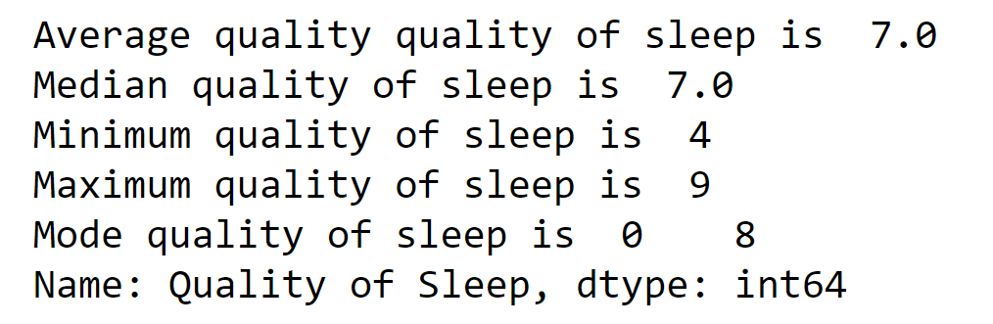
Quality of Sleep
Quality of sleep is the measurement of how well someone sleeps at night. The average adult needs 7 or more hours of restful and restorative sleep.

Slide 9
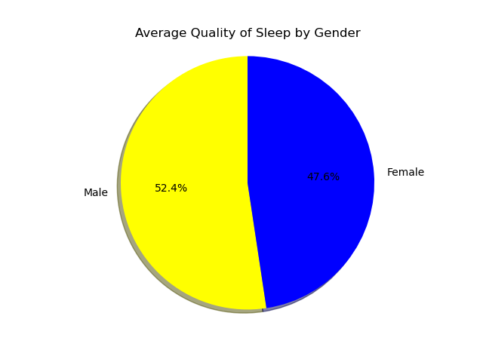
Which Gender Gets the Better Quality of Sleep?
In this dataset, 185 males and 189 females were analyzed. On average, the men from the dataset get a more restful and restorative sleep. Men, on average, received 8 hours of quality sleep, while women received 7 hours.

Slide 10
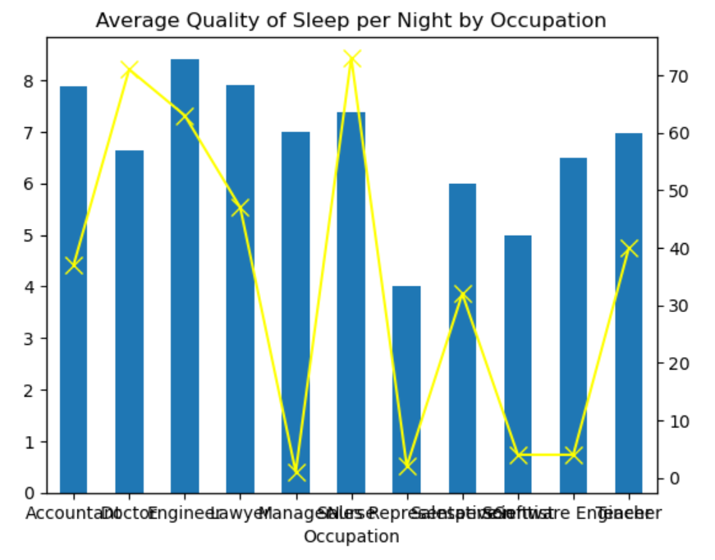
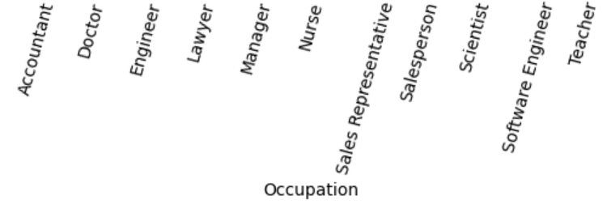
Which Profession Gets Better Quality of Sleep?
Eleven professions were analyzed from different industries. This graph represents the average quality of sleep per occupation compare to the total count of each occupation.
The uneven count of each profession proves to be a limitation to our data. For example, Manager occupation only has only 1 count and an average quality of sleep, where as doctor has a 71 count and a below average quality of sleep.
Notes:
The left y-axis represents the average quality of sleep per profession, while the right y-axis represents the total count per profession.

